Slide 1
Project Big Data:
DC Residentials
Yasin Aydin - 2657725
Faruk Simsekli - 2657316
Bob Mes - 2650287
Atal Atmar - 2651146

Slide 2
Dataset
158,957 properties in Washington DC
48 columns:
Price
Number of rooms, bedrooms, kitchens
Year of built
Most recent sale date
Condition
Land area
Quadrant
Address
...

Slide 3
How does the age affect the selling price?
Linear model with R-squared of 0,009.
Model does not fit
Based on this, age has no effect on the selling price

Slide 4
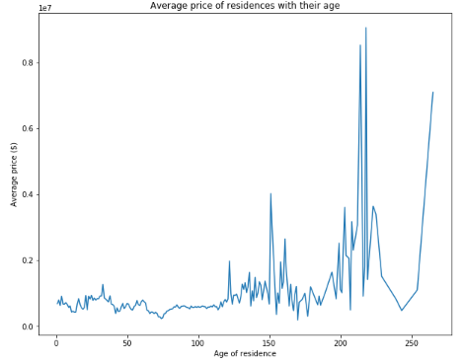
How does the age affect the selling price?

Slide 5
How does the gross building area affect the selling price?
Linear model with R-squared of 0,657 and P-value less than 1 %
Model does fit, but is not great
Can be used to get an indication of the effect on price

Slide 6
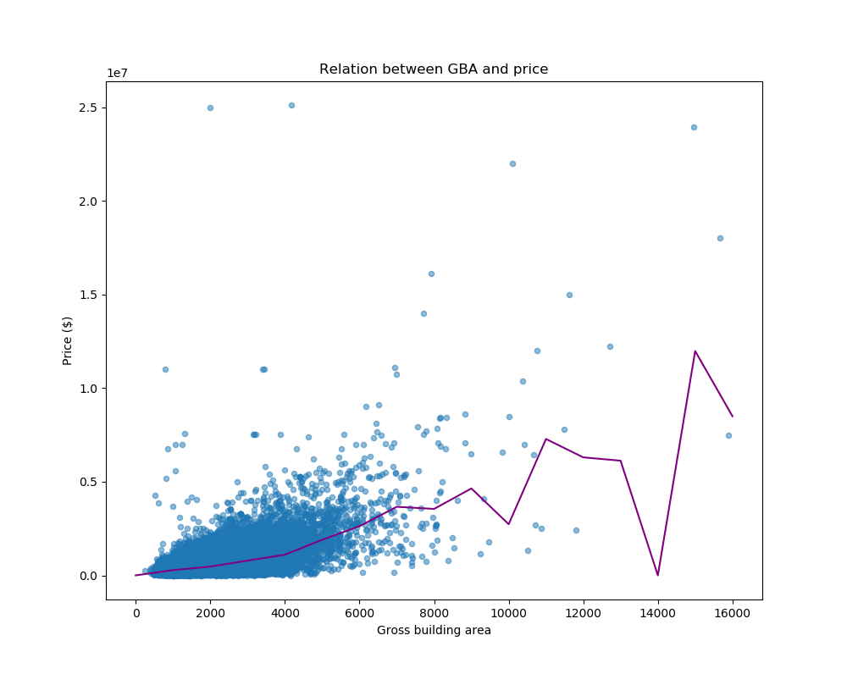
How does the gross building area affect the selling price?

Slide 7
How did the sale price of homes change over time?

Slide 8
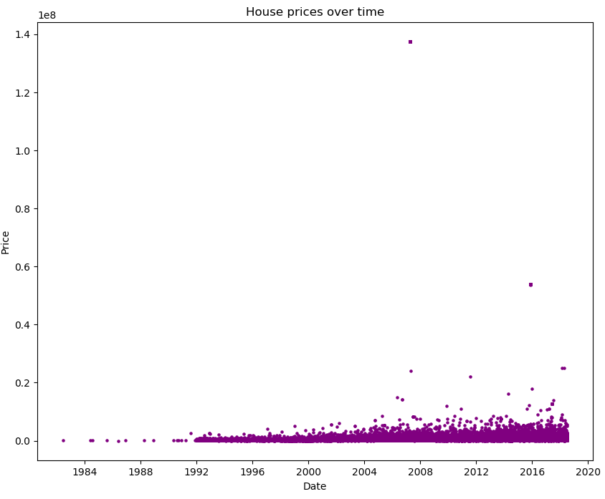
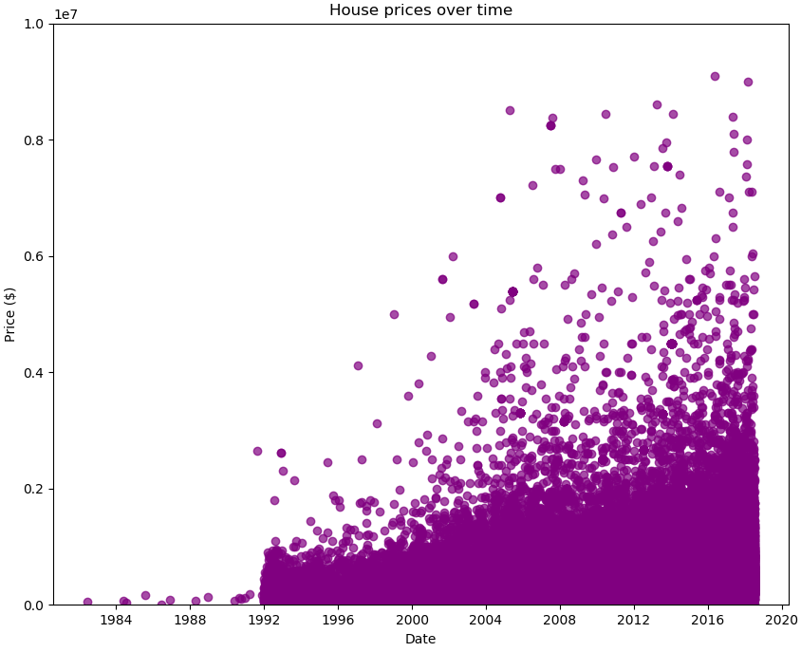
How did the sale price of homes change over time?

Slide 9
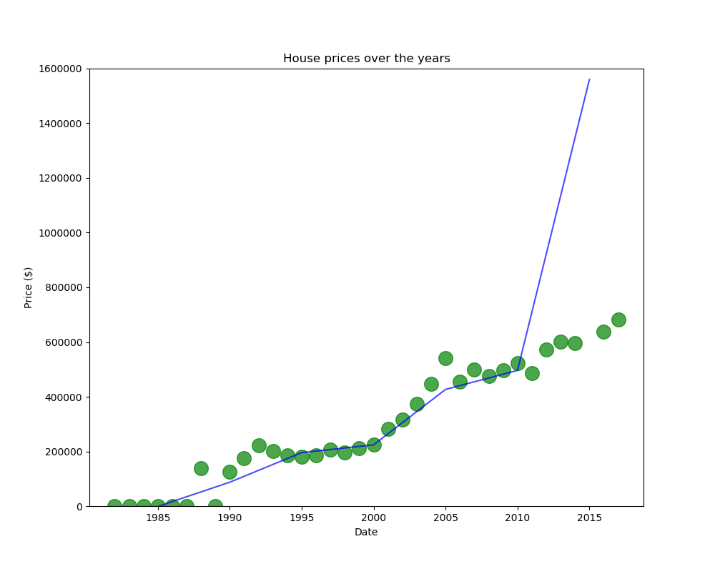
How did the sale price of homes change over time?

Slide 10
S&P 500
The S&P 500 is an American stock market index based on the market capitalizations of 500 large companies

Slide 11
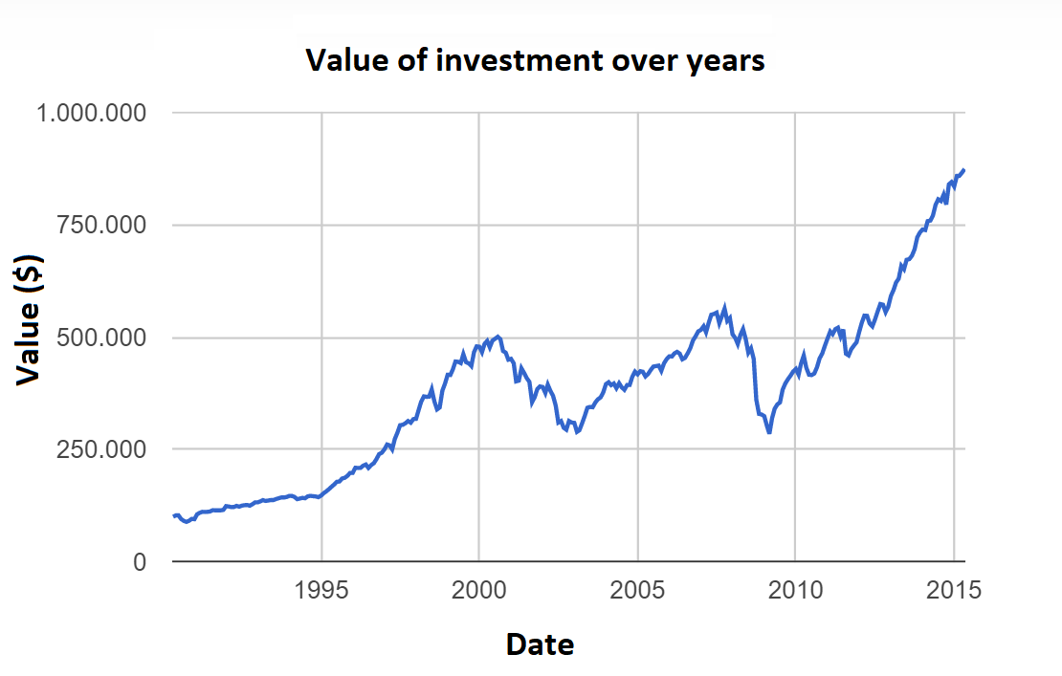
S&P 500
https://dqydj.com/sp-500-periodic-reinvestment-calculator-dividends/

Slide 12
Which one is more profitable?
S&P 500
DC Residentials

Slide 13
RESULTS
Investing $100.000 for 25 years.
Investment on S&P 500
Risk
Investment on DC Residentials
Lower risk

Slide 14
RESULTS
Investing $100.000 for 25 years.
Investment on S&P 500
Risk
No additional expenses needed
Return: $781.022
At least 8% extra profit according to these results
Investment on DC Residentials
Lower risk
Additional expenses needed for renewing the residence
Return: $722.784

Slide 15
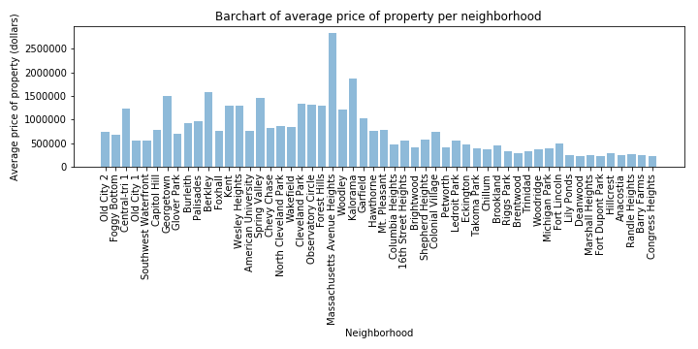
How does the neighborhood of the home affects its sale price?

Slide 16
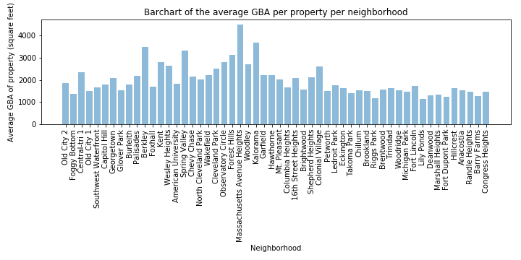
How does the neighborhood of the home affects its sale price?

Slide 17
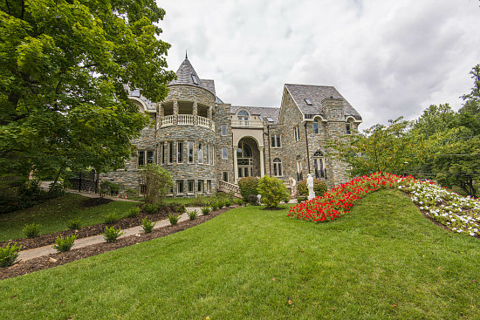
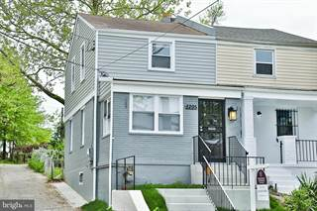
How does the neighborhood of the home affects its sale price?
https://dc.urbanturf.com/articles/blog/dcs_million-dollar_neighborhoods/11489
https://www.point2homes.com/US/Home-For-Sale/DC/Washington/Deanwood/5205-JUST-STREET-NE/76655132.html

Slide 18
What is the impact of Great Recession in 2008 on house marketing in Washington D.C?

Slide 19
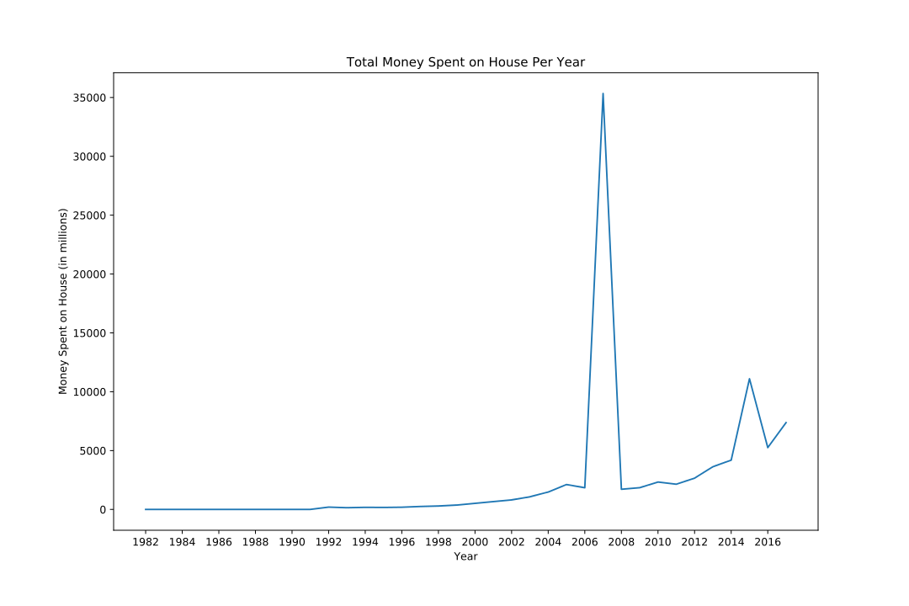

Slide 20
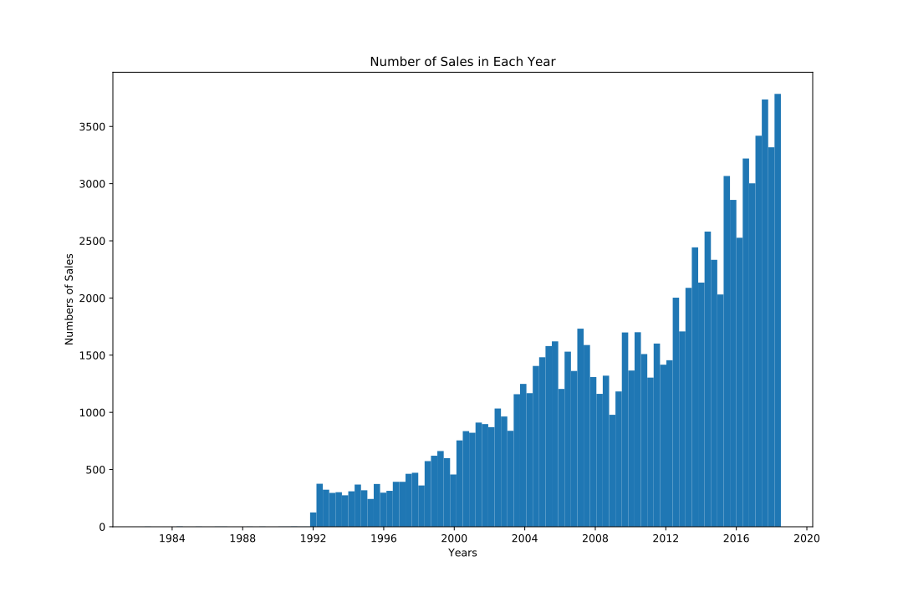

Slide 21
Questions?

Slide 22
Thank you for listening.

